Slide 1
WISE Internet of Things Working Group – Concept discussion August 15, 2017 - Washington, DC Florence D. Hudson, Senior Vice President and Chief Innovation Officer, Internet2

Slide 2
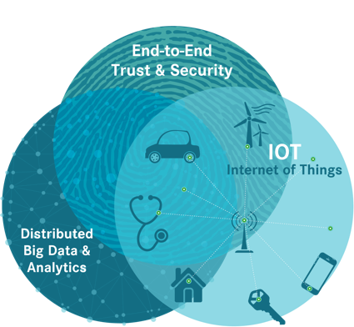
IoT security is an important area for Research & Education
End-to-End Trust & Security for IoT a top Innovation focus area in 2015 Internet2 member survey.
TIPPSS for IoT need identified via IEEE, Internet2, NSF “E2ET&S for IOT” workshop in 2016 due to risk in research and education – Financial, Reputational, Physical, Data, Operational
E2E Trust & Security (E2ET&S)
TIPPSS for IoT – Trust, Identity, Privacy, Protection, Safety, Security
NSF EAGER Cybersecurity Transition to Practice Acceleration
SDP (Software Defined Perimeter), Network Segmentation for IoT
Distributed Big Data & Analytics (DBDA)
Health & Life Sciences / Genomics
Smart Campuses and Cities
NSF Big Data Hub Collaboration
Internet of Things (IoT)
IoT Sandbox
Smart Campuses and Cities
Smart Grid Testbed
Notes:
In a March 2015 member survey on Internet2 Collaborative Innovation Opportunities, 66% of survey respondents identified E2ET&S as a top innovation area for open collaborative innovation; 45% for DBDA; 45% for IoT. The Innovation Working Groups were announced at the Global Summit 2015, based on the March 2015 member survey.

Slide 3
Where is the IoT On Campus: In Short… Everywhere…
Facilities
Building Temperature Control Systems
Electrical Systems
Lighting Systems
VoIP Phones
Trash Cans
Water Sensors for Floods
Building Equipment Monitoring
Motors, Pumps, Boilers, etc.
Safety
IP Video Surveillance
Fire Alarm and Life Safety Systems
Security Alarms
Electronic Door Access
IP enabled Police and Security Teams
IP Enabled Police Vehicles
Classroom Technologies
Clickers in the Classroom
Projectors
IP Streamed Audio
Computer Presentation Integration
Tutoring Spaces
Check in / out for Tutoring
AV equipment
Scheduling Devices
IP Connected Laboratory Equipment
Refrigerators
Microscopes
Laboratory Probes (Frog Sensors)
Research
IP Connected Laboratory Equipment
Gene Sequencers
Functional MRI Machines
Irradiators
Refrigerators
Microscopes
Laboratory Probes (Frog Sensors)
Staff Offices
Multifunction Printers
Coffee Makers / Microwaves
IP connected mailboxes
Conference Room Scheduling
Conference Room Presentation Systems
Time Clocks
Transit Services
Vehicle Location Tracking & Reporting
Rider Tracking and Verification
Safety Monitoring
Rider Entertainment / Information
Parking Control and Wayfinding
Parking Pay Stations
Residential Services
Entertainment
Building Safety
Utility Monitoring and Bill Back
Building Access Control
Laundry Services
Disability Services
Text to Speech
Speech to Text
Call for Help
Health Monitoring
ADA Route Wayfinding
ADA Parking
Sports and Fitness
Wearable Fitness Trackers
IP connected Sports Equipment
Treadmills, Bikes, etc.…
Attendance / Admission Control
Sporting Event Management / Fan Interaction
Microphones to measure cheering levels during events
Ticket / Seating Verification
Venue Facilities Management
Physical and Mental Health
Appointment Scheduling
Medical Appointment Notes
Diagnostic Medical Equipment

Slide 4
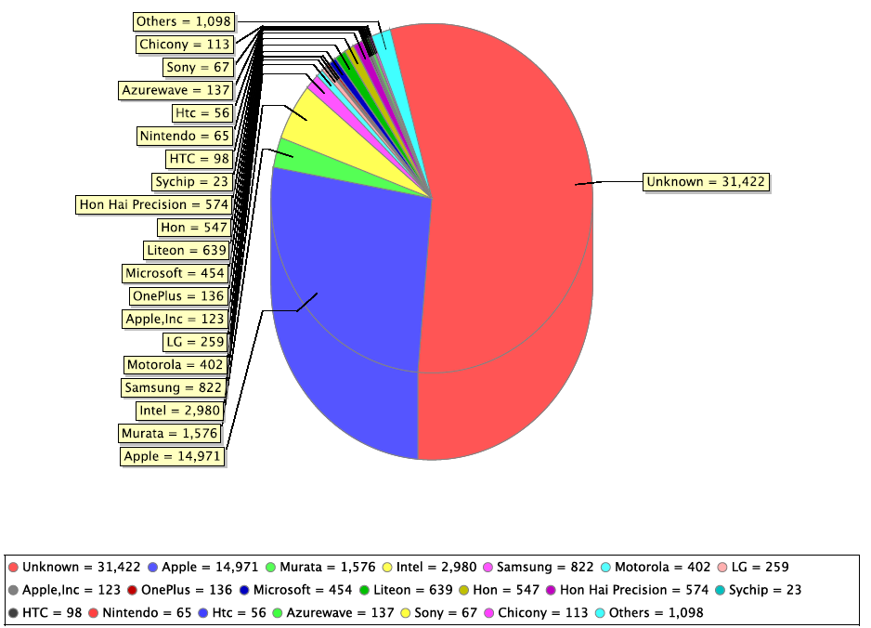
Distinctive - What’s on Your Network

Slide 5
IoT security is an area of growing importance for Research & Education
IoT is everywhere on campus...and growing
Scientific instruments – old unpatched systems, “custom” instruments, new devices, etc.
The devices in the buildings of the e-infrastructures are hackable – cameras, BMS, etc.
Are we using networking segmentation for the Things and air-gapped? Always?
Students are bringing 7-10 devices to campus, connecting to the network
Multiple scientific domains – physics, healthcare & life sciences, genomics (human, plant & animal), etc.
Risks include scientific data integrity / availability, reputation, financial, physical, operational, confidentiality
Notes:
In a March 2015 member survey on Internet2 Collaborative Innovation Opportunities, 66% of survey respondents identified E2ET&S as a top innovation area for open collaborative innovation; 45% for DBDA; 45% for IoT. The Innov
Have we already solved the IoT security challenge for scientific devices and e-infrastructures, and if so can we share those best practices with R&E Enterprise IoT / smart campus efforts?
Do we need an IoT security maturity model for research & education, and/or for e-infrastructures?
ation Working Groups were announced at the Global Summit 2015, based on the March 2015 member survey.

Slide 6
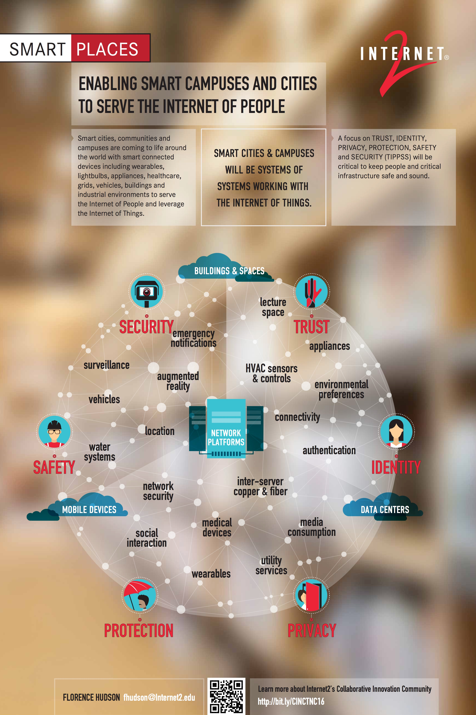
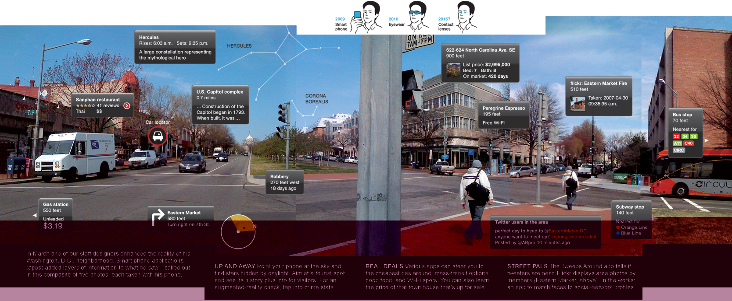



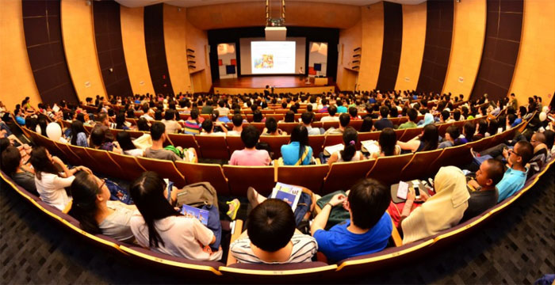



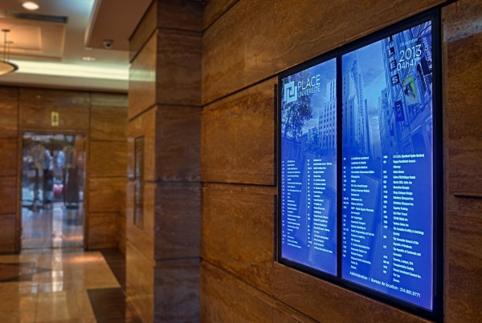


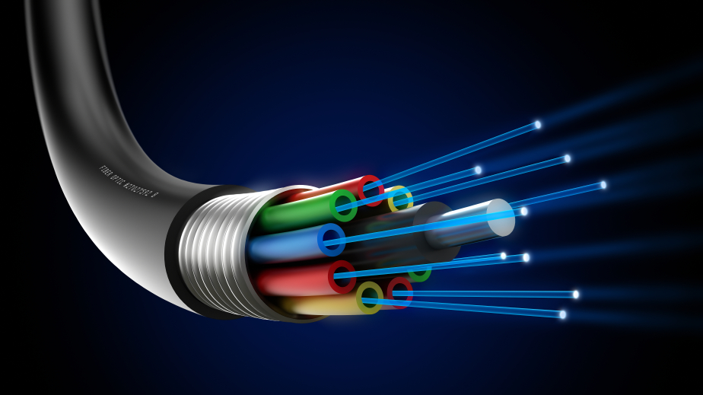



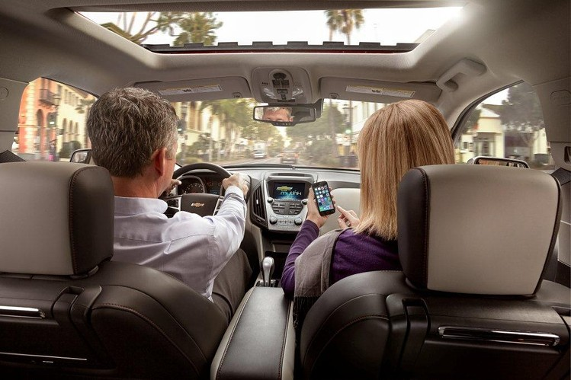
Addressing TIPPSS is essential to achieving safe, secure, scalable future smart campus architectures, plus keep research and facilities safe and secure.
Trust: Allow only designated people/services device or data access
Identity: Validate the identity of people, services, and “things”
Privacy: Ensure device, personal & sensitive data is kept private
Protection: Protect devices and users from harm
Safety: Provide safety for devices, infrastructure and people
Security: Maintain security of data, devices, people, etc.
Augmented Reality
Augmented Reality
Emergency
Notifications
Emergency
Notifications
Buildings & Facilities
Buildings & Facilities
Lecture Space
Lecture Space
Social
Interaction
Social
Interaction
Environmental
Senses
Environmental
Senses
Location
Location
Location
Support
Location
Support
Network Platforms
Network Platforms
Water Systems
Water Systems
Real-Time
Collaboration
Real-Time
Collaboration
Content
Delivery
Content
Delivery
HVAC Sensors
& Controls
HVAC Sensors
& Controls
User Senses
Media
Consumption
User Senses
Media
Consumption
Data
Center
Data
Center
Inter-Server Copper & Fiber
Inter-Server Copper & Fiber
Authentication
Authentication
Mobile Device
Mobile Device
Connectivity
Network Security
Connectivity
Network Security
Vehicles
Vehicles
Notes:
Across elements of a connected ecosystem:
Users
Devices
Gateways
Communications
Clouds
Software
Services
Data
Hardware
Firmware

Slide 7
What is going on in R&E re: Internet of Things related Security
Internet2 IoT Systems Risk Management Task Force deliverables – on Internet2 CINO Wiki
“How to find devices connected to your campus network” - http://bit.ly/ShodanCensys
“IoT Vendor Management Considerations for Higher Education” - http://bit.ly/IoTsysvendreq
Joint ITANA (IT Architects In Academia) / Internet2 Enterprise IoT working group
https://docs.google.com/document/d/100mjiAu9k3Al6JEUhO-w1JEKx3pjvXnMq7sEWXLCYhk/edit
PEARC17 discussions regarding Cybersecurity needs in HPC e-infrastructures
Presentation of Cybersecurity Research Transition To Practice Acceleration workshops for researchers & users (U.S. NSF Early Concept Grant for Exploratory Research EAGER #1650445)
CASC discussion begun and forthcoming (CASC = Coalition for Academic Scientific Computation)
U.S. National Telecommunications & Information Administration process for IoT Security, Upgradability & Patching https://www.ntia.doc.gov/other-publication/2016/multistakeholder-process-iot-security
14

Slide 8
IoT in e-infrastructure context…let’s discuss
What proportion of IP’s in use in your e-infrastructure belong to servers and to end user devices? Do those total to 100%? What else is there?...is it IoT?
What types of IoT devices are in use in or with your e-infrastructure?
Do you build any of your own things?
What are the specific risks that Things represent in your e-infrastructure?
What measures have already been taken to help address those?
How high up the list is IoT in your overall risk assessment? Is it in the right spot?
What role does or should your organization’s IT Security office play ?

Slide 9
If we were to create a WISE IoT Working Group...fill in the blanks
What problem should a WG address relevant to WISE members?
What are the risks?
What is the scope for an IoT WG for research/e-Infrastructures?
In scope?
Out of scope?
Deliverables?

Slide 10
If we were to create a WISE IoT Working Group…DRAFT CONCEPT
Mandate?
Enable e-infrastructure managers to assess their security risks due to IoT devices connected to the e-infrastructure and its facilities, and improve their security posture, protecting the data and devices in the e-infrastructure and associated research systems.
How to scope an IoT WG for research/e-Infrastructures?
How to assess and manage device security risks connected to e-infrastructures:
Scientific instruments which connect to e-infrastructures
Student and lab devices which connect to scientific facilities and e-infrastructure
IoT devices in buildings, cameras, personal devices, etc. connected to e-infrastructures
It just takes one connection to an exposed device…that’s all you need to communicate a breach
Deliverables?
Develop process document for assessment of security or TIPPSS risks for e-infrastructures and the devices to which they connect
Develop vendor management checklist for scientific instruments connected to e-infrastructures
Rules re: passwords, data feeds, who has access to the device, what service has access, etc.
Leverage Internet2/ITANA IoT WG deliverables, customize and extend for e-infrastructures
Add e-infrastructure things to Enterprise IoT Working Group checklist for ITANA/Internet2 effort

Slide 11













Discussion
Florence Hudson
fhudson@Internet2.edu
@FloInternet2
Ken Klingenstein
kjk@internet2.edu

Slide 12
Back-up – TNC17 materials for Securing the Things

Slide 13
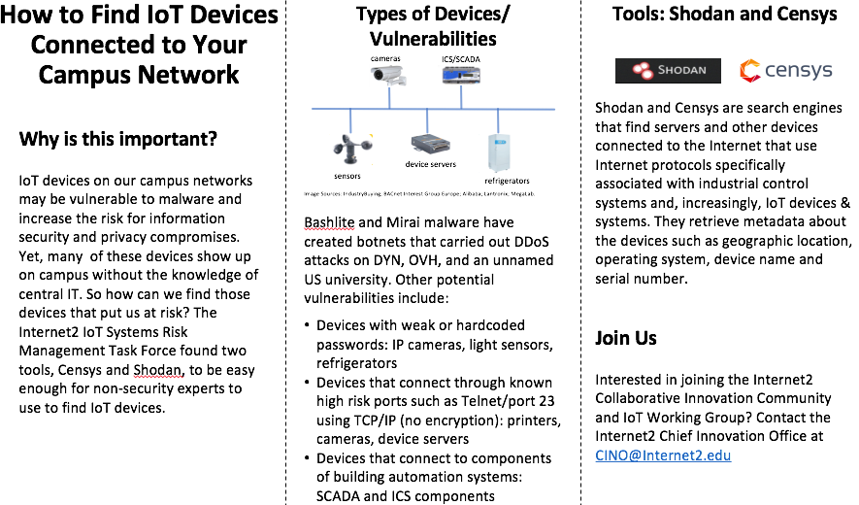
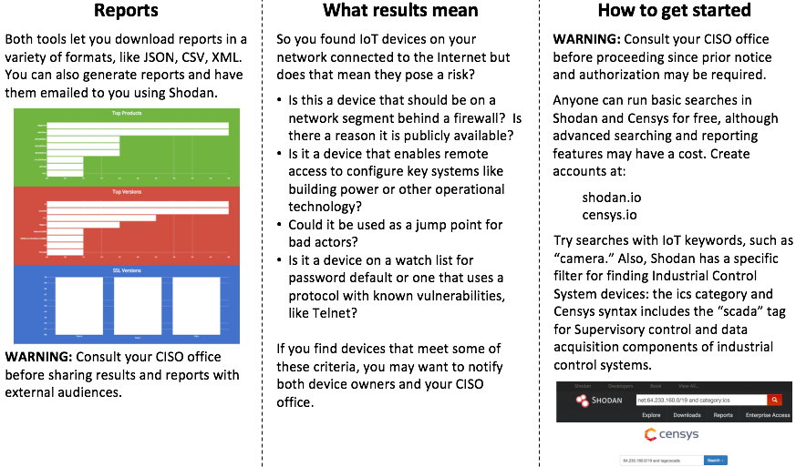
Internet2 IoT Systems Risk Management Task Force: Recommends Initial Exposure Baselining via Shodan & Censys tools.
Full document available:
http://bit.ly/ShodanCensys

Slide 14
Internet2 IoT Systems Risk Management Task Force: Developed IoT Systems Vendor Management Considerations Document.
This document is intended to provide different organizations within Higher Education institutions with items to consider as they engage with IoT systems vendors at the different phases of selection, procurement, deployment and management.
IoT systems are selected, acquired and deployed by higher ed institutions through multiple paths.
The historical acquisition approach of selection, acquisition, deployment and management of traditional enterprise IT systems through central IT is not sufficient for IoT systems.
Questions to consider in organizational approaches to IoT systems and vendor management.
Who will monitor and manage the device?
Is there a data feed to the device? Who will create and support it? Who will secure it?
Are there trust, identity, privacy, protection, safety and/or security considerations?
Is there a patch and upgrade plan? Who will do the patching? Who manages the plan?
Are there interdependencies between any of these IoT systems? Who manages that?
Is there a separate network segment for the IoT devices? Is it air gapped?
Full document available: http://bit.ly/IoTsysvendreq

Slide 15
Enterprise Managed IoT
Ken Klingenstein

Slide 16
Topics
Distinctive R&E Use cases
Enterprise Management of IoT
The middleware layer of enterprise IoT management
A vendor checklist and next steps

Slide 17
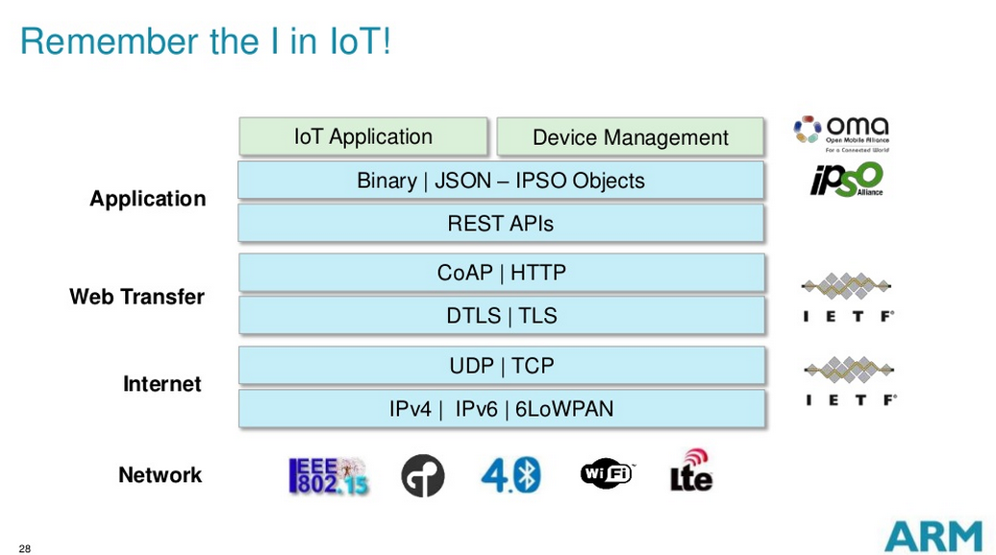
One Layered View

Slide 18
Where can the enterprise help manage IoT?
Where and how to put management?
The IP network?
Data link layer controls?
REST API’s
Who does management?
Facilities
Campus IT
Purchasing
What’s the business model
Governance
Funding

Slide 19
What Can the Middleware Layer Provide
How do our central middleware concepts- authentication, authorization, delegation, etc. add value to IoT?
Registries – what’s needed for things?
May feed into TIER activities
Is the work within IETF useful and ready?
CORE - Constrained RESTful Environments
ACE - Authentication and Authorization for Constrained Environments
Lots of interest in checklists for vendors and purchasing

Slide 20
A Vendor Checklist for R&E IoT
Aimed at providing assistance to a decentralized academic environment in managing IoT acquisitions and deployments.
Reflect enterprise needs and risks in distributed acquisitions
Several potential audiences: Institutional Leadership and Risk Management, Central IT, purchasing, departmental managers, etc.
Key touchpoints include
Network needs/loads/port requirements etc.
Data feeds
Security: Access control to devices and data; software patch plans, etc.
Contract monitoring and performance, Risk management, etc.
https://spaces.internet2.edu/pages/viewpage.action?pageId=98306986&preview=/98306986/110334355/I2GS17-VendorManagementDoc041717-FINAL.pdf.

Slide 21
Next steps on Vendor Checklist
Convening a group to evolve the vendor checklist
Update some of the existing materials
Expand management dimensions
Investigate growing vendor use of Oauth and evaluate enterprise issues
Enterprise-IoT @ internet2.edu
Emily Nichols of Internet2 can help <enichols@internet2.edu>

Slide 22
U.S. National Telecommunications & Information Administration, U.S. Department of Commerce Efforts
Multistakeholder Process for IoT Security Upgradability and Patching
Technical Capabilities and Patching Expectations Working Group
Capabilities Group - Components of An Update
Existing Standards, Tools, and Initiatives Working Group - IoT Standards Catalog
Communicating Upgradability and Improving Transparency Working Group
Incentives, Barriers, and Adoption Working Group
Internet2 university, regional, CINO participants
https://www.ntia.doc.gov/other-publication/2016/multistakeholder-process-iot-security

